Slide 1




Automatic Character Recognition in Porcelain Ware
David Álvarez
Santiago Garrido
Luis Moreno
Adriana Birlutiu
Manuella Kadar
Notes:
1
1

Slide 2
Automatic Character Recognition in Porcelain Ware
1 – Motivation
2 – Problem Description
3 – Segmentation Process
4 – Convolutional Neural Networks
5 – Results
6 – Summary & Future Works
Automatic Character Recognition in Porcelain Ware
Notes:
1
1

Slide 3
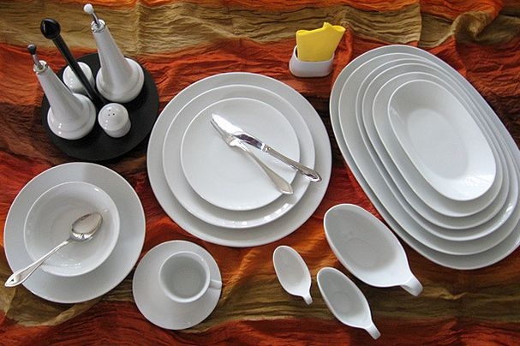
1 - Motivation
Manufacturing Process of Porcelain
Preparing the mass
Powder atomization
Shaping the object
Burning 1
Glazing
Burning 2
Quality control
Sorting
Automatic Character Recognition in Porcelain Ware
Notes:
1
1

Slide 4
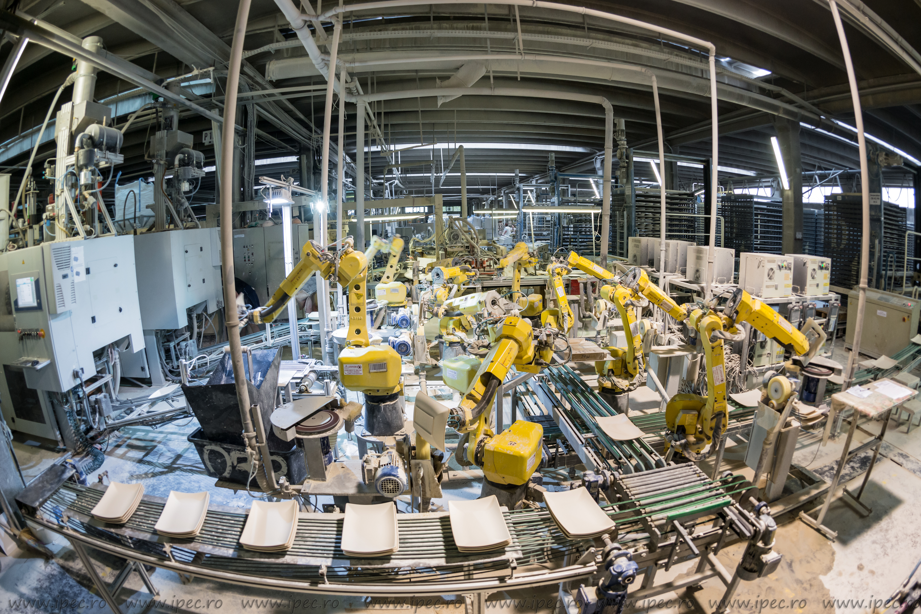
1 - Motivation
Automatic Character Recognition in Porcelain Ware
Notes:
1
1

Slide 5
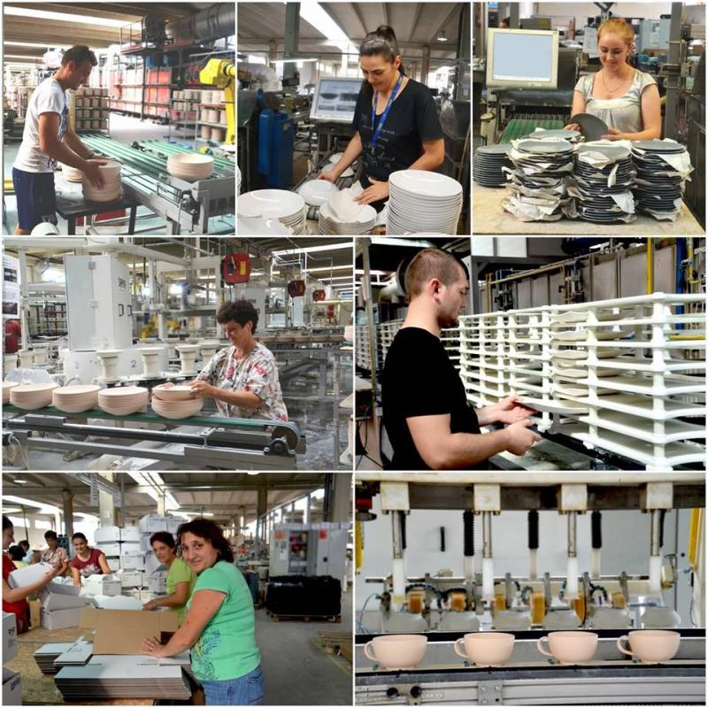
1 - Motivation
Quality control after:
1) Burning 1
2) Glazing
3) Sorting
Estimated cost reduction
- 60% in HR
- 20% materials
Automatic Character Recognition in Porcelain Ware
Notes:
1
1

Slide 6
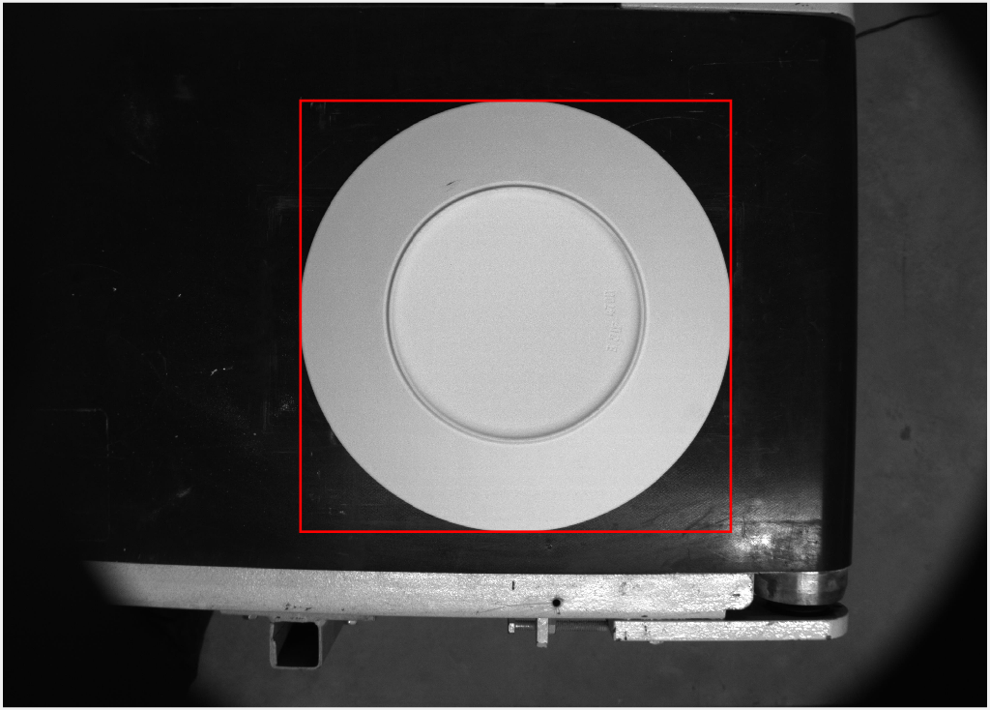
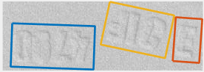
2 – Problem Description
3 groups of characters:
Sack of material
Shift
Product type
Automatic Character Recognition in Porcelain Ware
Notes:
1
1

Slide 7
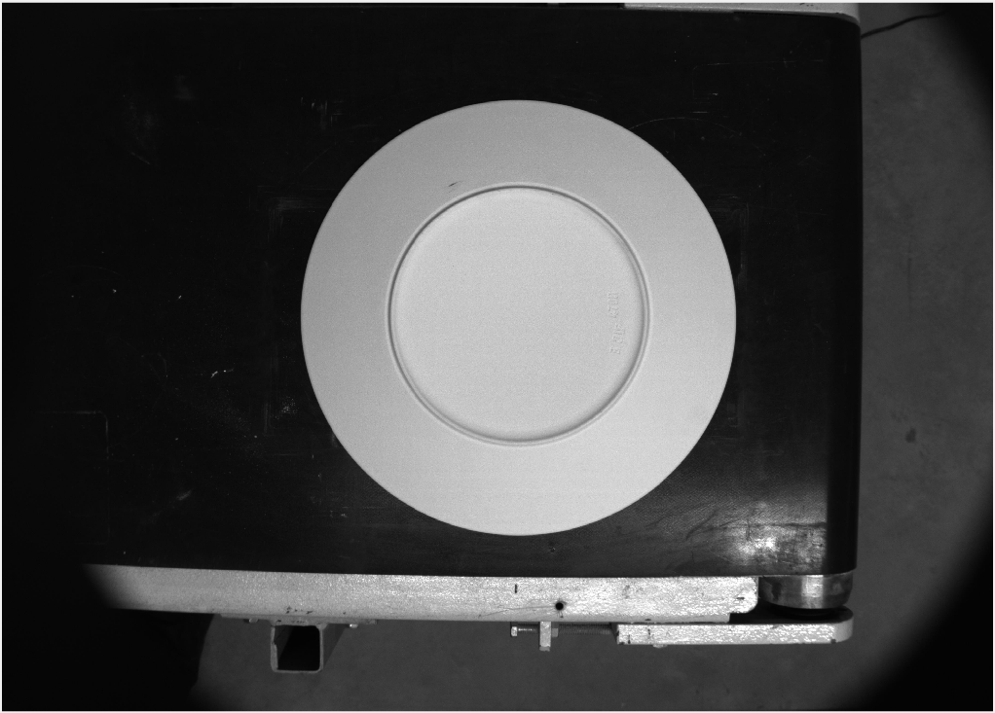
3 – Segmentation Process
Objective: segment individual characters
Solution: Recursively look for geometric properties and segment
Automatic Character Recognition in Porcelain Ware
Notes:
1
1

Slide 8
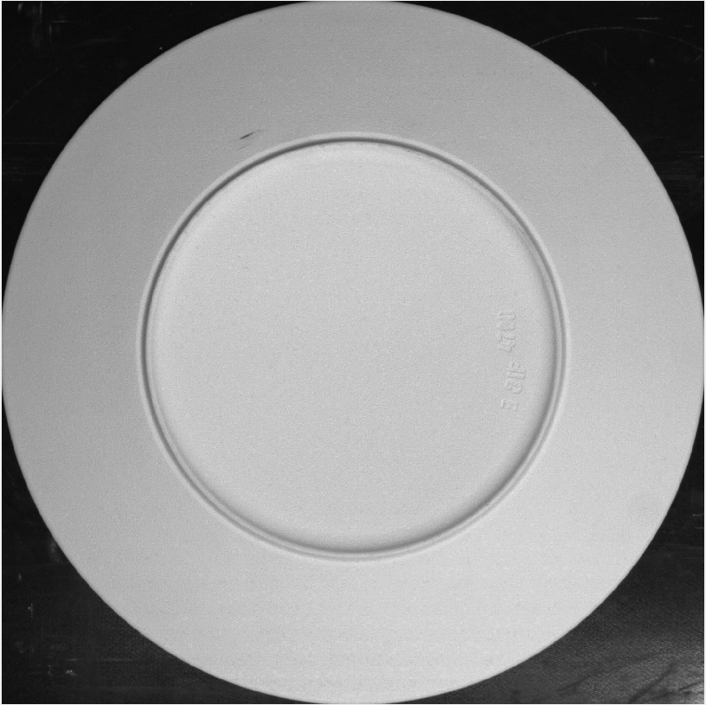
3 – Segmentation Process
Solution: Recursively look for geometric properties and segment
Outer Bounding Box of largest object
Automatic Character Recognition in Porcelain Ware
Notes:
1
1

Slide 9
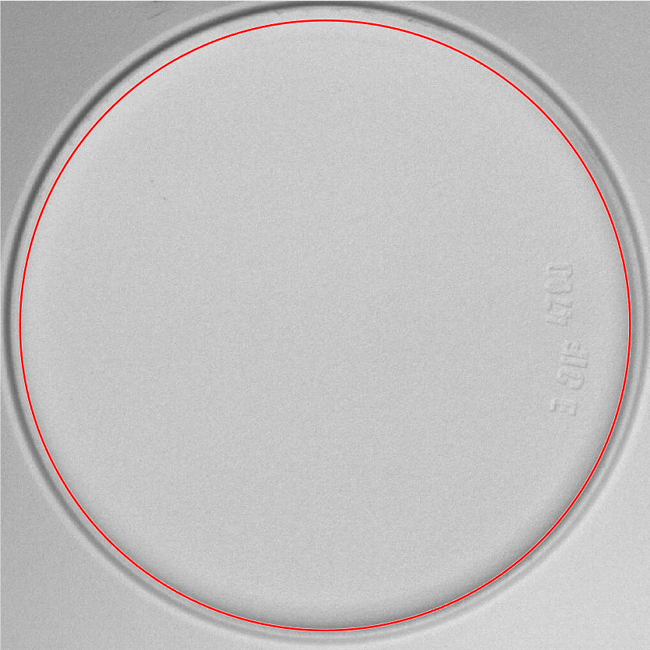
3 – Segmentation Process
Solution: Recursively look for geometric properties and segment
Segment inner circle
Automatic Character Recognition in Porcelain Ware
Notes:
1
1

Slide 10
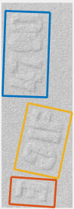
3 – Segmentation Process
Solution: Recursively look for geometric properties and segment
Automatic Character Recognition in Porcelain Ware
Notes:
1
1

Slide 11
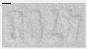
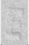
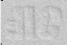
3 – Segmentation Process
Solution: Recursively look for geometric properties and segment
Size: 59*35
Automatic Character Recognition in Porcelain Ware
Notes:
1
1

Slide 12
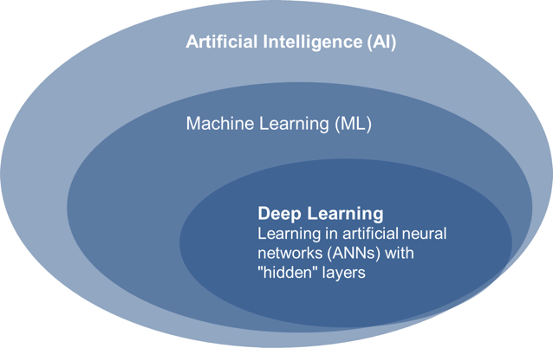
4 – Convolutional Neural Network
Automatic Character Recognition in Porcelain Ware
Notes:
1
1

Slide 13
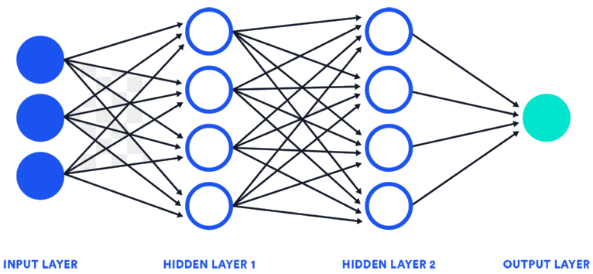
4 – Convolutional Neural Network
Automatic Character Recognition in Porcelain Ware
Notes:
1
1

Slide 14
5 – Results
Automatic Character Recognition in Porcelain Ware
Notes:
1
1

Slide 15
5 – Results
Automatic Character Recognition in Porcelain Ware
Notes:
1
1

Slide 16
6 – Summary & Future Work
Particle Filter + proprioceptive & tactile info = in-hand object localization
From the first contact to the stabilization of the grasp, the movements can be detected.
Fusion visual and tactile information to deal with additional DOFs.
Automatic Character Recognition in Porcelain Ware
Notes:
1
1

Slide 17
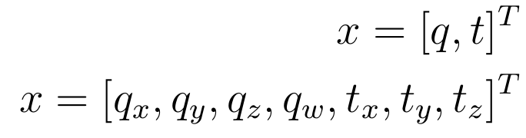
2 – Problem Description
Automatic Character Recognition in Porcelain Ware
Notes:
1
1

Slide 18
Automatic Character Recognition in Porcelain Ware
David Álvarez Sánchez
Notes:
1
1

